Slide 1
Lecture 9
Harmony of the Self with the Body
(Understanding Prosperity and Health)

Slide 2
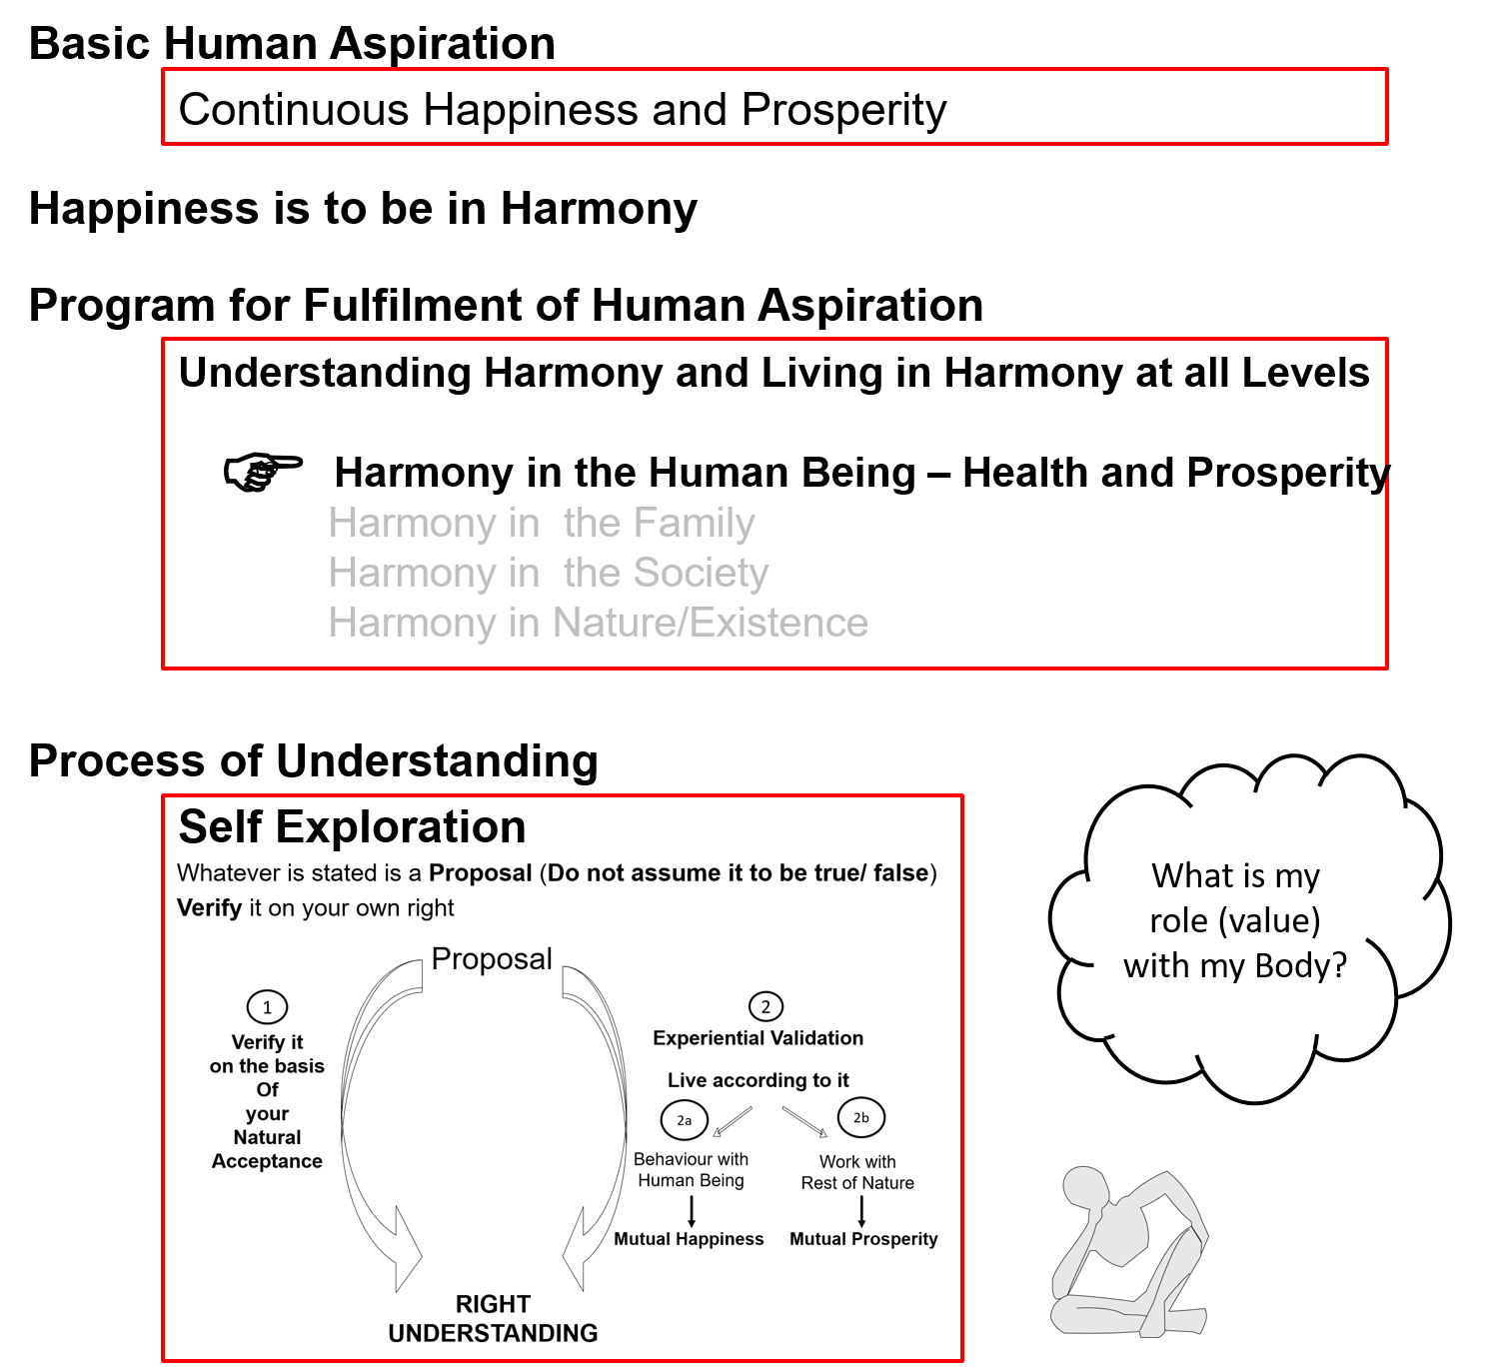

Slide 3
Human Being Ekkuo | Self eSa | Body “kjhj
Need vko';drk | Happiness (e.g. Respect) lq[k ¼tSls lEeku½ | Physical Facility (e.g. Food) lqfo/kk ¼tSls Hkkstu½
In Time dky esa | Continuous fujUrj | Temporary lkef;d
In Quantity ek=k esa | Qualitative (is Feeling) xq.kkRed ¼Hkko gS½ | Quantitative (Required in Limited Quantity) Ekk=kRed ¼lhfer ek=k esa½
Fulfilled By iwfrZ ds fy, | Right Understanding & Right Feeling lgh le>] lgh Hkko | Physio-chemical Things HkkSfrd&jklk;fud oLrq
Activity fØ;k | Desire, Thought, Expectation… bPNk] fopkj] vk”kk--- | Eating, Walking… [kkuk] pyuk---
In Time dky esa | Continuous fujUrj | Temporary lkef;d
Response | Knowing, Assuming, Recognising, Fulfilling tkuuk] ekuuk] igpkuuk] fuokZg djuk | Recognising, Fulfilling igpkuuk] fuokZg djuk
 | Consciousness pSrU; | Material tM+
Co-existence
lgvfLrRo

Slide 4
Self Body
Consciousness |  | Material
I am |  | My body is
I want to live |  | My body is used as an instrument
I want to live with continuous happiness |  | Physical facility is required for nurturing, protection and right utilization of the body
To understand and to live in harmony at all levels of being (from self to entire existence) is my program of action for continuous happiness |  | Production, protection and right utilization of physical facility is a part of my program (<1/4th)
I am the: Seer, Doer, Enjoyer (Experiencer) nz’Vk] drkZ] HkksDrk |  | I use the body as an instrument for fulfillment of my program
INFORMATION
Instruction
Sensation
The Self is
central to human existence
The Body is
an instrument of the Self

Slide 5
Need of the Self Related to Need of the Body
RIGHT UNDERSTANDING
(le>)
in the self
1
Both needs must be satisfied for human-being to be fulfilled
2
RELATIONSHIP (laca/k)
with human beings
3
PHYSICAL FACILITY
(lqfo/kk)
with rest of nature
Feelings
- Trust
- Respect
- …
MUTUAL HAPPINESS
(mHk; lq[k)
MUTUAL PROSPERITY
(mHk; le`f))

Slide 6
Activities of Self eSa dh fdz;k,a
 | Power “kfDr
1.
2.
3. | Desire bPNk
4. | Thought fopkj
5. | Expectation vk'kk
Activity fØz;k
Imaging fp=.k
Analysing-Comparing fo'ys"k.k&rqyu
Selecting-Tasting p;u&vkLoknu
Self verification on the basis of Natural Acceptance
lgt Loh—fr ds vk/kkj ij tkap dj
Self eSa
3
Preconditioning
ekU;rk
1
Imagination
dYiuk”khyrk
Information
Body 'kjhj
2
Sensation
laosnuk
Behaviour O;ogkj
Work dk;Z

Slide 7
Self Body
Consciousness |  | Material
Needs: Happiness, Prosperity → Continuity |  | Physical Facility
Needs & activities are continuous in time |  | Temporary in time
INFORMATION
Instruction
Sensation
Self is central to human existence
Body is
an instrument of the Self

Slide 8
Self Body (Instrument)
Consciousness |  | Material
Needs: Happiness, Prosperity → Continuity |  | Physical Facility
Needs & activities are continuous in time |  | Temporary in time
Self-regulation
Feeling of responsibility toward the body – for Nurturing, Protection and Right Utilization of the Body
INFORMATION
Instruction
Sensation

Slide 9

Self Body (Instrument)
Consciousness |  | Material
Needs: Happiness, Prosperity → Continuity |  | Physical Facility
Needs & activities are continuous in time |  | Temporary in time
Self-regulation |  | Health
Feeling of responsibility toward the body – for Nurturing, Protection and Right Utilization of the Body |  | 1. Body acts according to I 2. Parts of the body are in harmony (in order)
INFORMATION
Instruction
Sensation
Physical Facility is required to fulfill the responsibility of the Self toward the Body
(to keep the Body in good health)
– for nurturing, protection and right utilisation of the body
The required physical facility can be identified

Slide 10

Self Body (Instrument)
Consciousness |  | Material
Needs: Happiness, Prosperity → Continuity |  | Physical Facility
Needs & activities are continuous in time |  | Temporary in time
Self-regulation |  | Health
Feeling of responsibility toward the body – for Nurturing, Protection and Right Utilization of the Body |  | 1. Body acts according to I 2. Parts of the body are in harmony (in order)
Food… Clothes, Shelter... Instruments…
INFORMATION
Instruction
Sensation
The required physical facility can be recognised
along with the required quantity
The quantity of food… required for nurturing the body – is it limited or unlimited?
Clothes, shelter… for protection of the body – is it limited or unlimited?
Instruments, equipments… for right utilisation of the body – is it limited or unlimited?

Slide 11

Self Body (Instrument)
Consciousness |  | Material
Needs: Happiness, Prosperity → Continuity |  | Physical Facility
Needs & activities are continuous in time |  | Temporary in time
Self-regulation |  | Health
Feeling of responsibility toward the body – for Nurturing, Protection and Right Utilization of the Body |  | 1. Body acts according to I 2. Parts of the body are in harmony (in order)
Food… Clothes, Shelter... Instruments… Required Required Required in a in limited in limited limited quantity quantity quantity
INFORMATION
Instruction
Sensation
Physical Facility is required to to keep the body in good health,
so that right utilisation of the body can be ensured
i.e. physical Facility is required only for
nurturing, protection and right utilisation of the body
If we can see that, the physical facility for
nurturing, protection and right utilisation of the body
is required in a limited quantity,
then we can understand the meaning of prosperity

Slide 12
Harmony of the Self with the Body = Self-regulation (feeling of responsibility toward the body) in the Self and Health in the Body
Other than these 3 (Nurturing, Protecting and Right Utilization of the Body), what would you need PF for?
The outcome of putting in so much time & effort is only PF – and it has only this much utility
Have you been able to make an assessment of your need for PF?
Are you able to see whether you have more than what your needs are?
Ex: Find out – how much PF is required; how much PF is available; are you prosperous or deprived?

Slide 13
Prosperity (le`f))
Prosperity – The feeling of having / producing more than required Physical Facility
2 1
le`f) & vko”;d lqfo/kk ls vf/kd dh miyfC/k@ mRiknu dk Hkko
1 2
1 – Identification of required physical facility (including the required quantity)
– with right understanding
vko”;d lqfo/kk dk fu/kkZj.k & lgh le> ls
  2 – Ensuring availability/ production of more than required physical facility
  – with right skills
vf/kd dh miyfC/k@ mRiknu] HkkSfrd jklk;fud oLrqvksa dk & lgh gquj ls
A prosperous person thinks of right utilisation, nurturing the other
“ deprived “ “ “ accumulation, exploiting “ “
le`) O;fDr lnqi;ksx dk] nwljs dk iks"k.k djus dk lksprk gS
nfjnz “ laxzg “ “ “ “kks"k.k “ “ “ “

Slide 14

In a previous session, we had seen that we can observe two categories of human beings
blhfy, vHkh nks rjg ds euq”; fn[kkbZ nsrs gSa&
Lacking physical facility, unhappy deprived (lqfo/kk foghu nq[kh nfjnz )
Having physical facility, unhappy deprived (lqfo/kk laiUu nq[kh nfjnz )
While we want to be – tcfd ge gksuk pkgrs gSa&
Having physical facility, happy prosperous (lqfo/kk laiUu lq[kh le`))
Now we can see that if the identification of required physical facility is missing, then one can only shift between category 1 & category 2
This is possible only with
a- the right identification of required physical facility and
b- availability / production of more than required physical facility

Slide 15
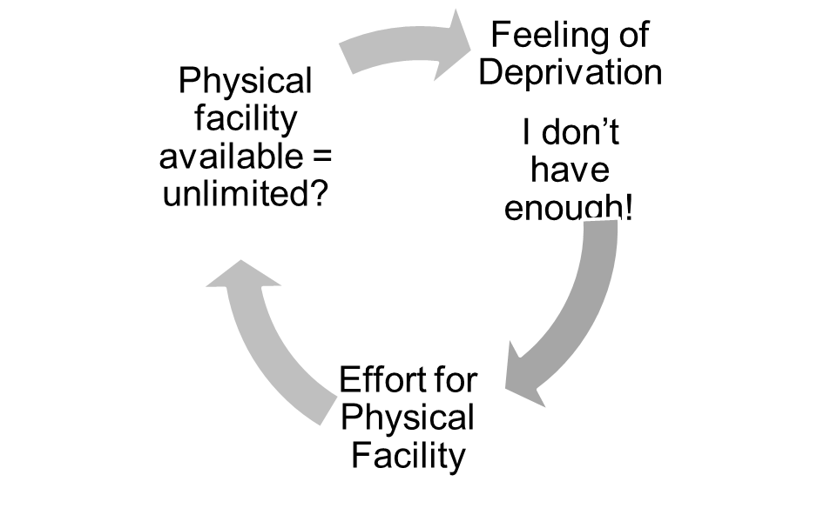
Gross Misunderstanding 1 – Human Being = Body
Assumption: Human being = Body
Needs of human being = physical facility
and feelings
Need for feelings (like respect) is continuous
All needs are fulfilled by physical facility
(Eg. clothes, house, car… will fetch respect)
Physical facility required = unlimited!

Slide 16
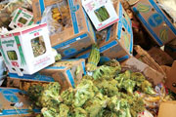
Gross Misunderstanding 2 – There is a Shortage of Physical Facility
Data: Of the 4.2 billion tons of food produced, more than 1 billion tons of food is lost or wasted every year, UN-backed report finds (11 May 2011)
About a third of all the food produced for human consumption each year – or roughly 1.3 billion tons – is lost or wasted, according to a new study commissioned by the United Nations Food and Agriculture Organization (FAO)
Global Food Production is 6 times requirement
Global Food Wastage is 1/3rd of production
Wastage is enough to feed 1300 crore people/year
Have we understood human needs?
Have we understood right utilisation?
Is it a question of production or distribution?
Is it a question of relationship?
Is it a question of right understanding?
It is a question of right education-sanskar
http://www.un.org/apps/news/story.asp?NewsID=38344&Cr=fao&Cr1

Slide 17
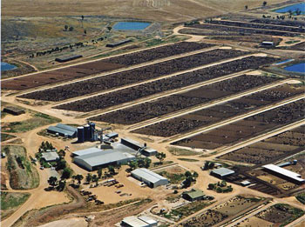
Even Small Individual Choices Add Up. E.g. Choice of Food
20% of all life produced on land every year is harvested for human purposes
14-16 kg grain & 21,000 litres of water → 1 kg meat
The world's cattle alone (not including other livestock) annually consume food grains enough for 8.7 billion people
Land use – 3¼ acres/person on meat diet vs 0.2 acres/person on veg diet
20% Amazon rain forest (the size of California) destroyed since 1970
80% of this land is used for cattle raising
By feeding grain to livestock, we lose 90% of the protein, 96% of the calories, 99% of its carbohydrates, and 100% of the fiber. Animal-based diets are high in saturated fat, excessive protein and cholesterol, leading to heart disease and stroke (nearly 50% of all deaths in the US)
Video (1 min)
http://www.planetaryrenewal.org/ipr/vegetarian.html

Slide 18
Health of the Body

Slide 19
Self Body (Instrument)
Consciousness |  | Material
Needs: Happiness, Prosperity → Continuity |  | Physical Facility
Needs & activities are continuous in time |  | Temporary in time
Self-regulation |  | Health
Feeling of responsibility toward the body – for Nurturing, Protection and Right Utilization of the Body |  | 1. Body acts according to I 2. Parts of the body are in harmony (in order)
INFORMATION
Instruction
Sensation

Slide 20
Program for Fulfillment of Feeling of Self-regulation
Self-regulation in the Self : Feeling of responsibility toward the body – for Nurturing, Protection and Right Utilization of the Body
Program for Fulfillment of Feeling of Self-regulation
  1a. Intake 1b. Daily routine
  2a. Labour 2b. Exercise
  3a. Balancing internal & 3b. Balancing breathing of body
  external organs
  of body
  4a. Medicine 4b. Treatment
Health in the Body
  1. Body acts according to Self
  2. Parts of the body are in harmony (in order)
1a. Intake includes air, water, sunlight, food (food is nutritious, digestible & tasty and waste is excretable)…
1b. Rising time, sleeping time, eating time…
2a. Outcome of labour is production of physical facility
2b. No physical facility is produced by exercise

Slide 21
Harmony of the Self with the Body → Harmony in the Body
There is a feeling of responsibility in the self toward the body
– for nurturing, protection and right utilization of the body
Program for harmony in the body
  1 Intake and Daily Routine (Lifestyle)
  2 Labour and Exercise
  3 Postures for regulating internal & external body organs and Regulated Breathing
  4 Medicine and Treatment
There is harmony in the body (body remains healthy)
  Body acts according to self
  Parts of the body are in harmony (in order)
(A) Staying Healthy
(B) Bringing body back to harmony from temporary disharmony
(C) Dependence on drug / machine to perform a body function

Slide 22
Sum Up
Human Being is co-existence of Self and Body
The Self is central to human existence; Body is an instrument of the Self
The transaction between Self and Body is only in the form of information
Physical Facility is required, in a limited quantity, for Nurturing, Protection & Right Utilisation of the Body
Prosperity = Feeling of having / producing more than required physical facility
  Identification of required physical facility (including the required quantity) – with right understanding
  Ensuring availability/ production of more than required physical facility – with right skills
The Self and the Body are in Harmony when there is a feeling of Self-regulation in the Self and Health in the Body
  Self-regulation = Feeling of responsibility toward the body – for Nurturing, Protection and Right Utilization of the Body
  Health = The body acts according to Self and parts of the body are in harmony (in order)

Slide 23
Self Reflection

Slide 24
Self Reflection
Do you have a feeling of Self-regulation (responsibility toward your body)? – continuous?
Is your body healthy?
Find out – how much physical facility is required in your family; how much physical facility is available. An on that basis are you prosperous or deprived?
Do you have a feeling of prosperity? – continuous?
Do you think of
    Right utilisation of physical facility and nurturing others (human beings / rest of nature)?
    Accumulating more physical facility or exploiting others?

Slide 25
Questions?

Slide 26
FAQ
How can we find out how much money is required i.e. determine our physical needs? I am asking because prices keep changing and there is no guarantee that we will not have some accident or some illness where we don’t know how much the treatment will cost. We have to include insurance for all these contingencies…
Does Sayam mean self control or self restraint? What exactly is the English word for Self-regulation?
If we become satisfied, then there will be no motivation for development. So many great inventions took place during world wars, like operations research, like radar… What is your comment on it?
If there is relationship and prosperity, then there is no need for corruption! How can we reach this knowledge to those doing all this corruption?

Slide 27
Some Implications of a wrong assumption
If the assumption is Human Being = Body
Then happiness is sought through
  sensation (through the body) or
  getting the right feeling from the other
As a result
  The body is harmed due to excessive consumption or over indulgence to get favourable sensation
  Continuity of happiness can not be ensured
  There is a major impact on family, society, nature…
e.g.
Over eating, consumption of "junk food" etc. is common
A large number of diseases are psychosomatic in nature
Today many of the complaints are related to the lack of feeling

Slide 28
Why “More than Required Physical Facility”
If my family is prosperous, then:
We identify the required physical facility for the family (including the required quantity) – with right understanding
We produce more than the required physical facility using cyclic, mutually enriching process – with right skills
We consume as much as is required (for nurturing, protection & right utilisation of the body), and not more – with a feeling of Self-regulation
We share the rest for mutual fulfillment in relationship & for order in society – with a sense of responsibility in relationship

